Slide 1
Project 3: Classification MODEL
machine learning
Prediction of an American view toward computers algorithm based on the data collected from a Pew Research Center Survey done in 2018
Fabrice MESIDOR
Cohort ‘side-bayes - 07152019’
September 20, 2019

Slide 2
WHAT’S MY AGENDA?
INTRODUCTION
CONTEXT
THE DATA
EXPLORATORY DATA ANALYSIS
MODELING
CONCLUSION

Slide 3
JUSTIFICATION
Development of machine learning
Computer decisions running our life
How people consider these decisions
Questions: social demographic and how we use data impact on our perception

Slide 4
OBJECTIVES OF THE STUDY
Academic research
Build data science portofolio
Find out if the xxx can help us predict yyy
HYPOTHESIS

Slide 5
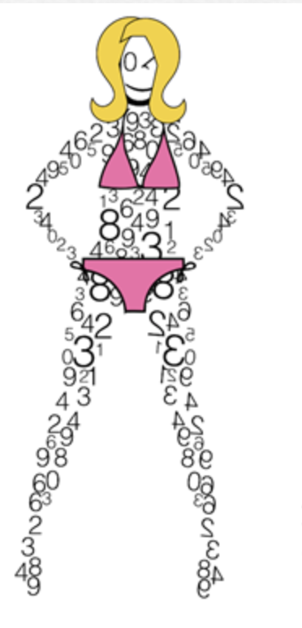

WHAT DATA?
EXPLORING DATA
MODELING
Where did it come from?
How did I treat it?
What did I keep?
How is distributed my target?
What about the features?
Are they correlated?
Different models used?
Model selected? Mode of selection
Testing and Validation?

Slide 6
THE DATA USED

Slide 7
METHODOLOGY

Slide 8
VARIABLES

Slide 9
WHAT DATA?
EXPLORING DATA
MODELING
Where did it come from?
How did I treat it?
What did I keep?
How is distributed my target?
What about the features?
Are they correlated?
Different models used?
Model selected? Mode of selection
Testing and Validation?

Slide 10
DATA CLEANING AND TRANSFORMATION

Slide 11
TARGET VARIABLE DISTRIBUTION

Slide 12
DEMOGRAPHICS OF PEOPLE

Slide 13
FEATURES VS. TARGET

Slide 14
INDEPENDENCE OF FEATURES AND TARGET

Slide 15
WHAT DATA?
EXPLORING DATA
MODELING
Where did it come from?
How did I treat it?
What did I keep?
How is distributed my target?
What about the features?
Are they correlated?
Different models used?
Model selected? Mode of selection
Testing and Validation?

Slide 16
DIFFERENT MODELS USED

Slide 17
MODEL TUNING AND SELECTION

Slide 18
FINAL MODEL

Slide 19
TESTING MY MODEL

Slide 20
CONCLUSION

Slide 21
QUESTIONS???

